Slide 1
Data Structures Overview
CS 374

Slide 2
Why are we doing this?

Slide 3

Why are we doing this?
We can't do algorithms without data.
Different kinds of data requires different formats.

Slide 4
Unit Outline
Today – General overview. Project assigned.
Week 4 – Specific structures
Week 6 – Graphs, transition to graph algorithms.

Slide 5
Outline
Structures you've seen before
Contiguous
Linked
Stacks/Queues
Structures you may not have seen before
Hashing
Graphs
Definitions, round 1
Binary search trees
Heaps (ft. a very hand-wavy explanation)
Sets, UnionFind (ft. a very hand-wavy explanation)
Project

Slide 6
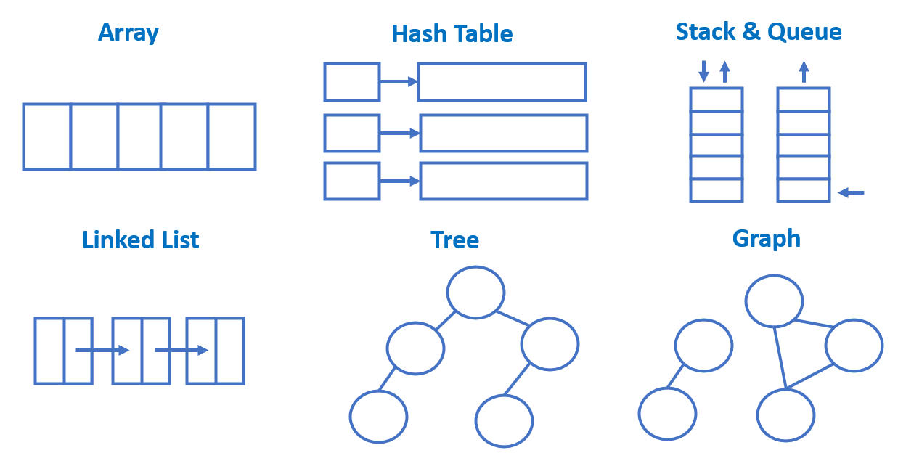

Slide 7
Contiguous Structures

Slide 8
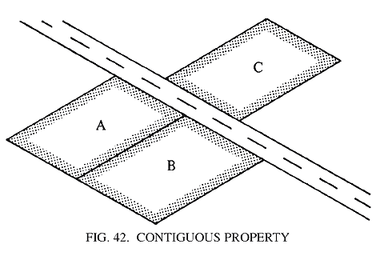

Contiguous
"sharing a common border; touching."
"next or together in sequence."
Synonyms: adjacent, neighboring

Slide 9
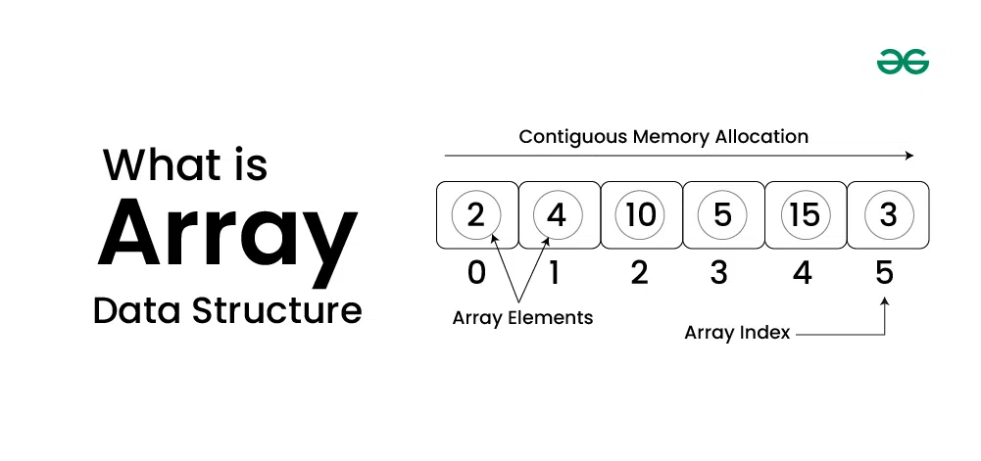
Arrays

Slide 10
Arrays
Fixed-size
Elements located by index/address
Typically lives all together in memory
Dynamic arrays allow for automatic re-sizing

Slide 11
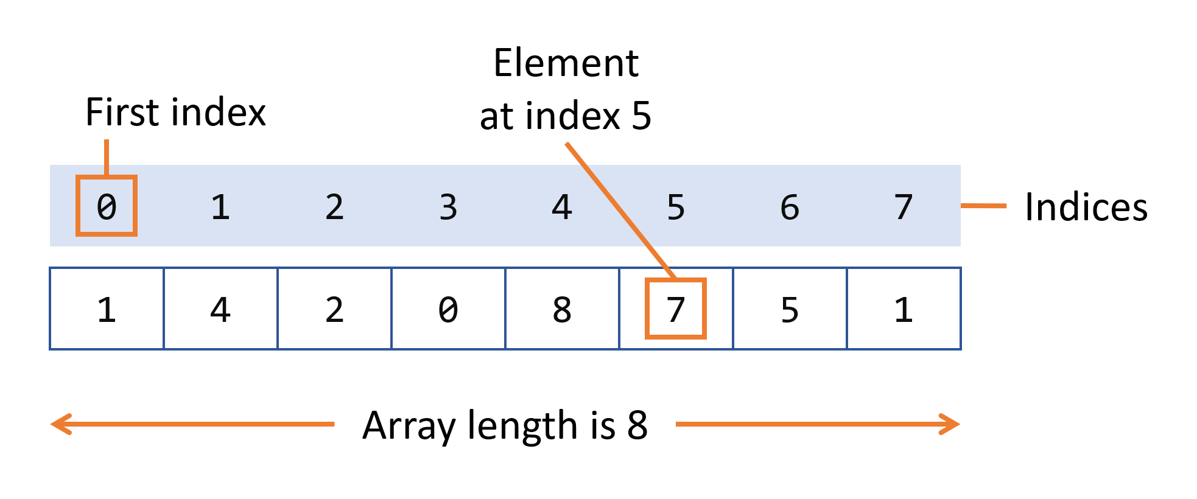
Array Visual

Slide 12
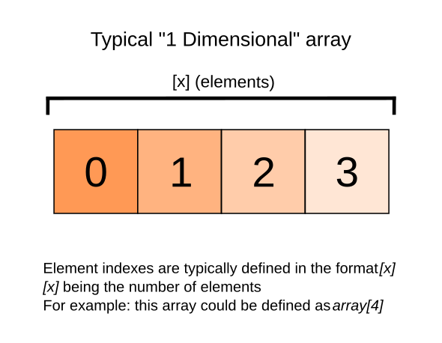
Array Visual

Slide 13
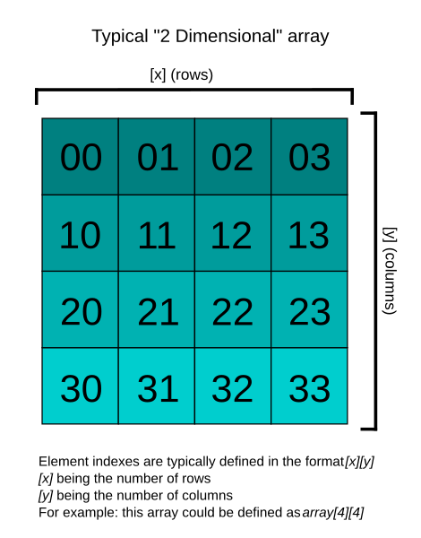
Array Visual

Slide 14
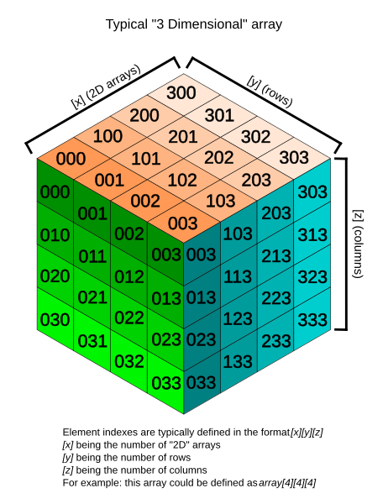
Array Visual

Slide 15
Array Operations
Search – O(n)
Access/Lookup – O(1)
Delete – O(n)
Others?

Slide 16
Linked Structures

Slide 17
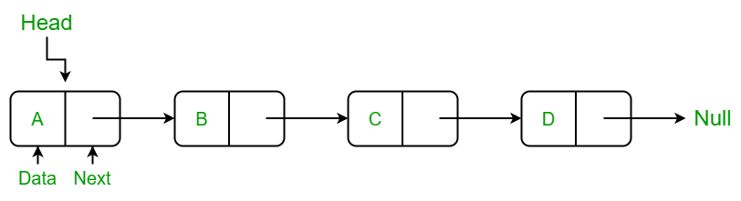
Linked Structures
Not contiguous in memory
Joined by pointers

Slide 18

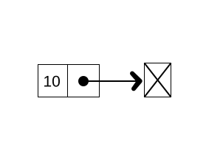
Linked Structures Visual

Slide 19
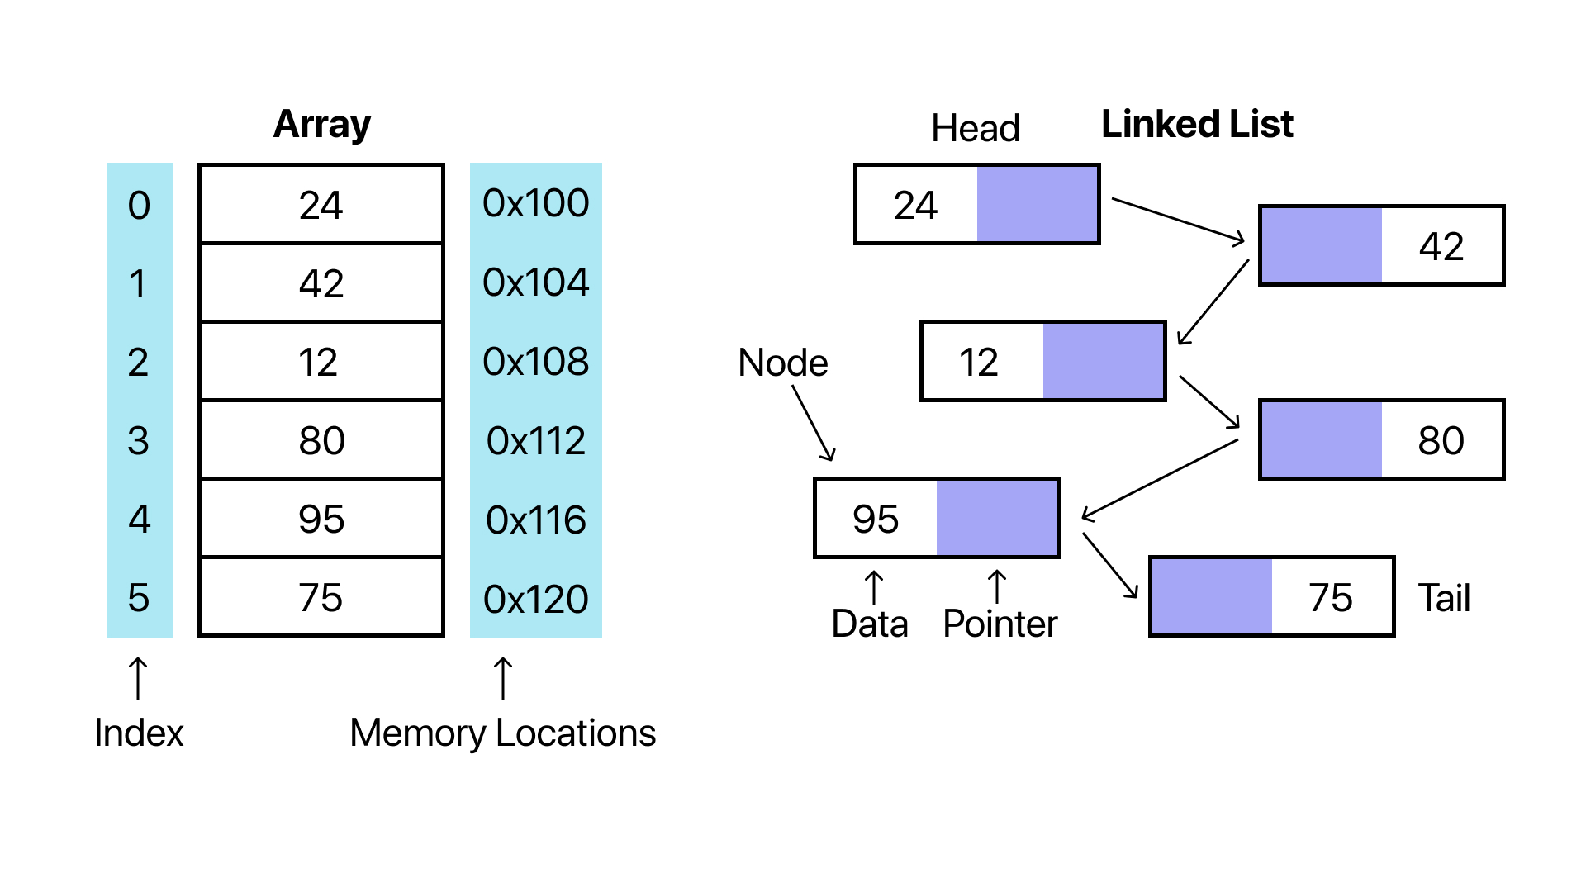
Linked Structures Visual

Slide 20
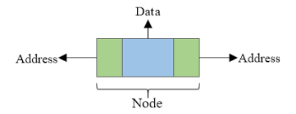
Linked Structure Visual

Slide 21
Linked List Operations
Search – O(n)
Access – O(n)
Insert – O(n)
At beginning: O(1)
At end (if "tail"): O(1)
Delete – O(n)
At beginning: O(1)
At end if tail & doubly linked: O(1)

Slide 22
Stacks & Queues

Slide 23
Stacks & Queues
Containers
Store data in a particular order
Retrieval depends on insertion order
FIFO vs LIFO
F=First
L=Last
I=In
O=Out

Slide 24
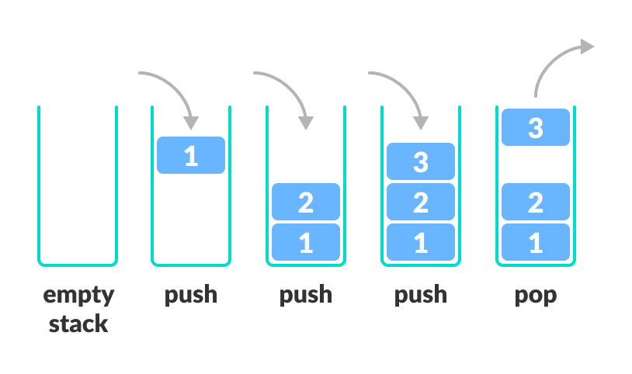

Slide 25

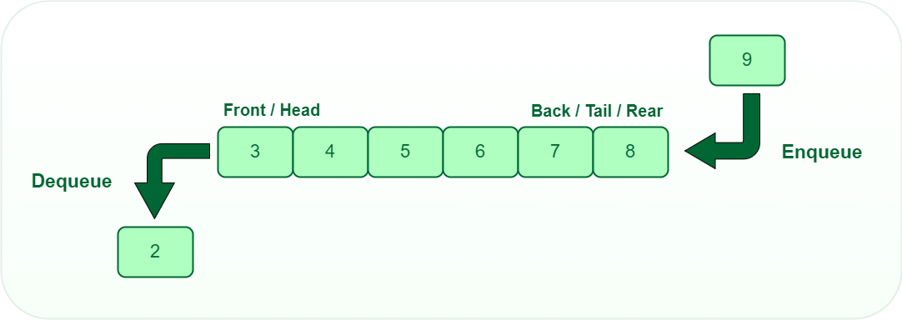

Slide 26
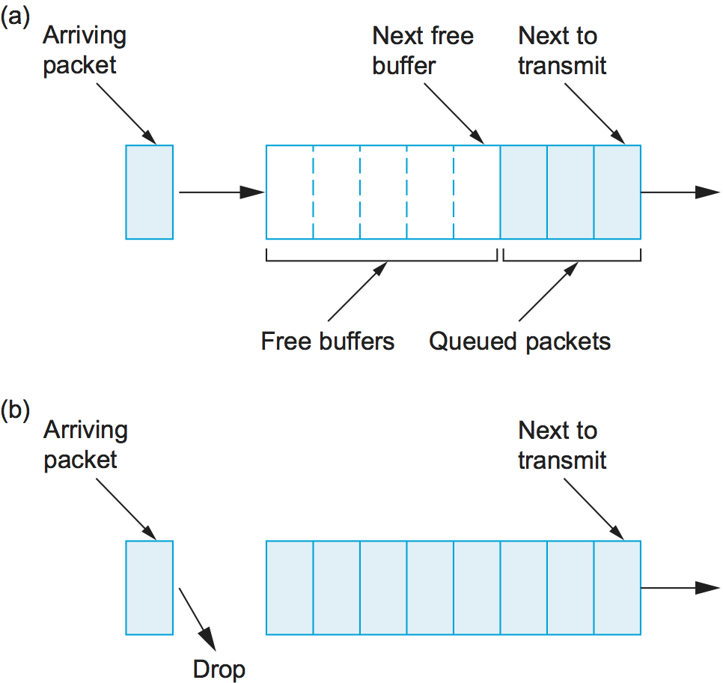
Notes:
Sort of thing is used in computer networks

Slide 27
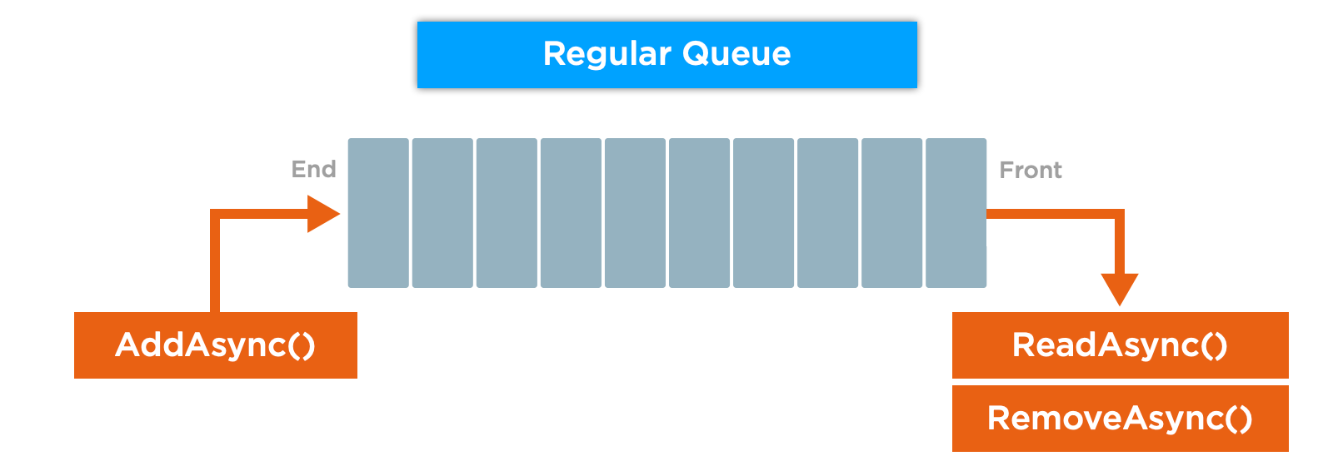
Notes:
From roblox

Slide 28
Stack Operations
Push (insert) – O(1)
Pop (delete) – O(1)
Access (top only, peek) – O(1)
"Not allowed":
Search
Lookup

Slide 29
Queue Operations
Enqueue (insert) – O(1)
Dequeue (delete) – O(1)
Double-ended also an option (deque)
Same "not allowed"s as Stacks

Slide 30
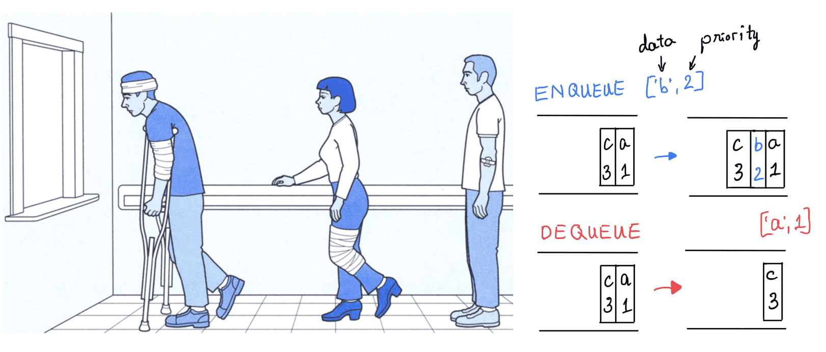
Priority Queue

Slide 31
Hashing/Dictionaries

Slide 32
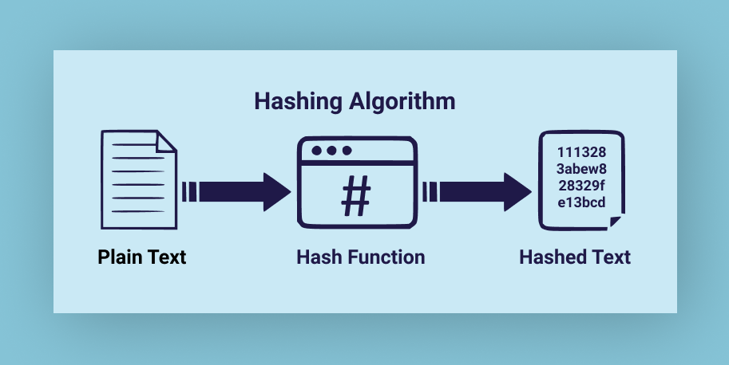

Slide 33
Hashing
A hash is a function that maps keys to an integer.
Used in dictionaries, etc. to help you find it
Also used for cryptography
Have a function, then mod by m to stick it into spot m in the structure
Collisions are an issue – what if two things have same hash?

Slide 34
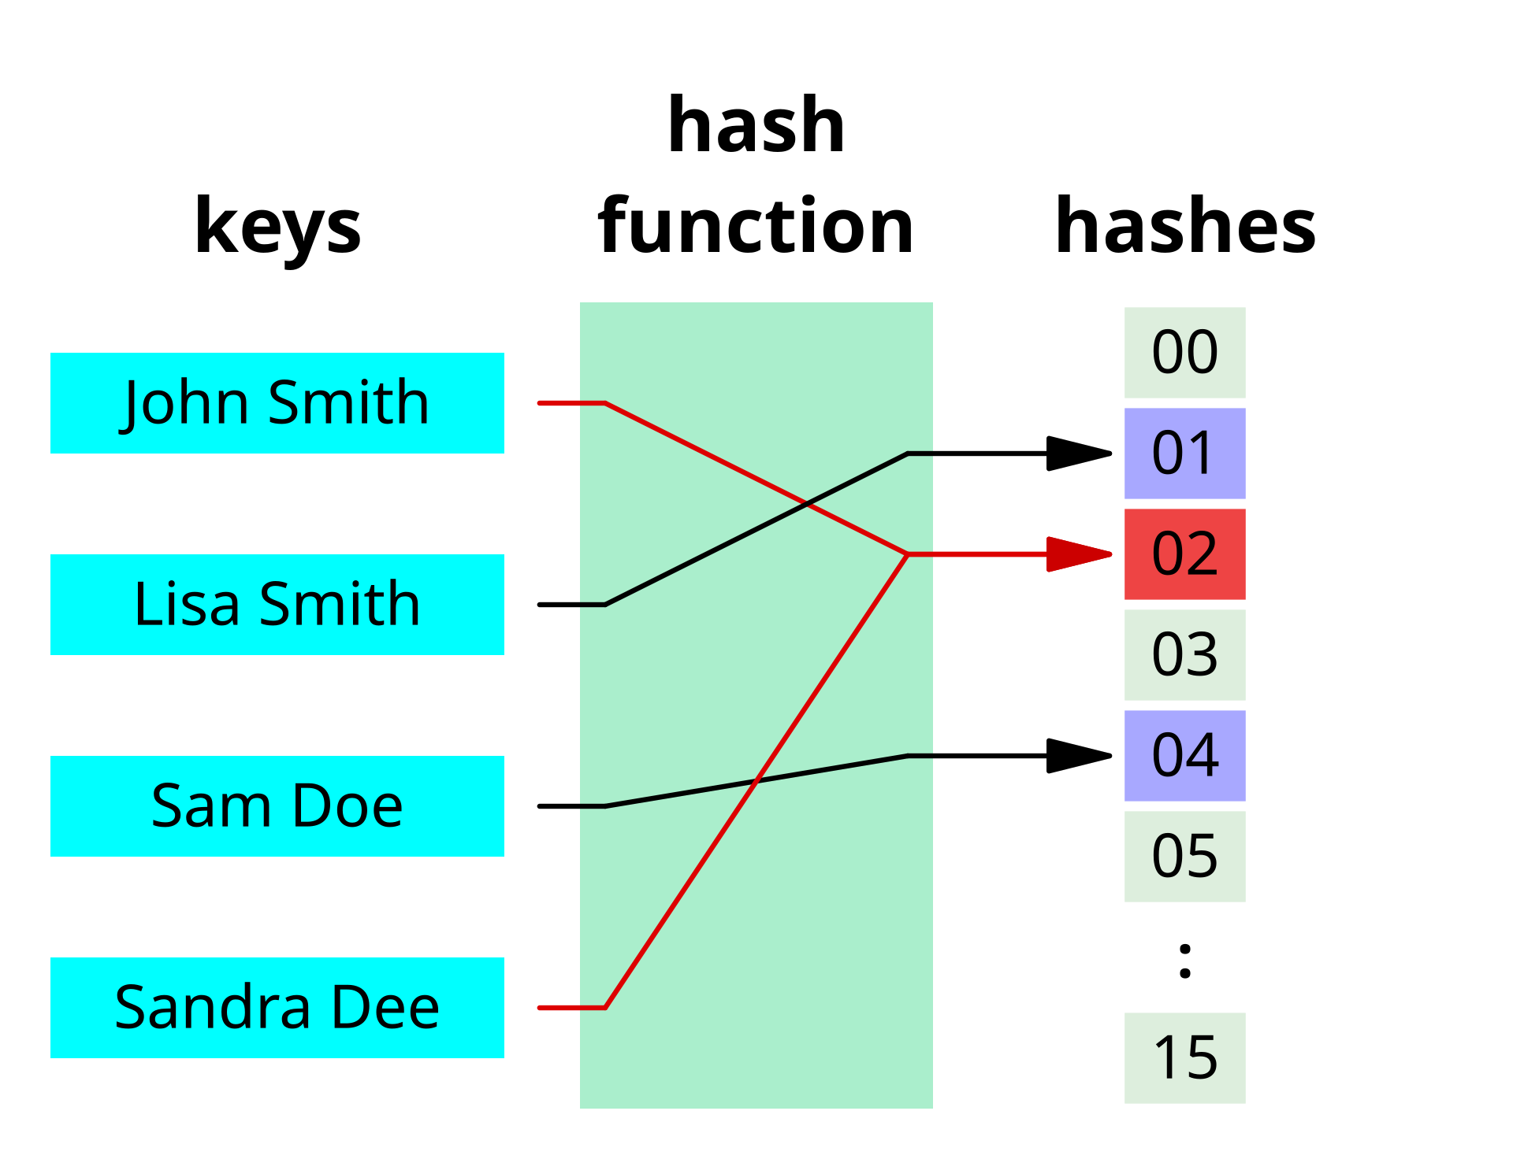

Slide 35
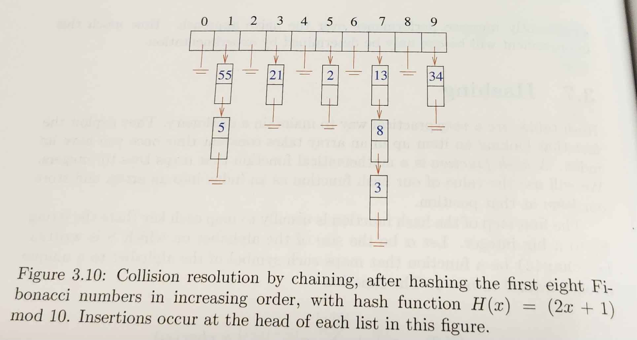

Slide 36
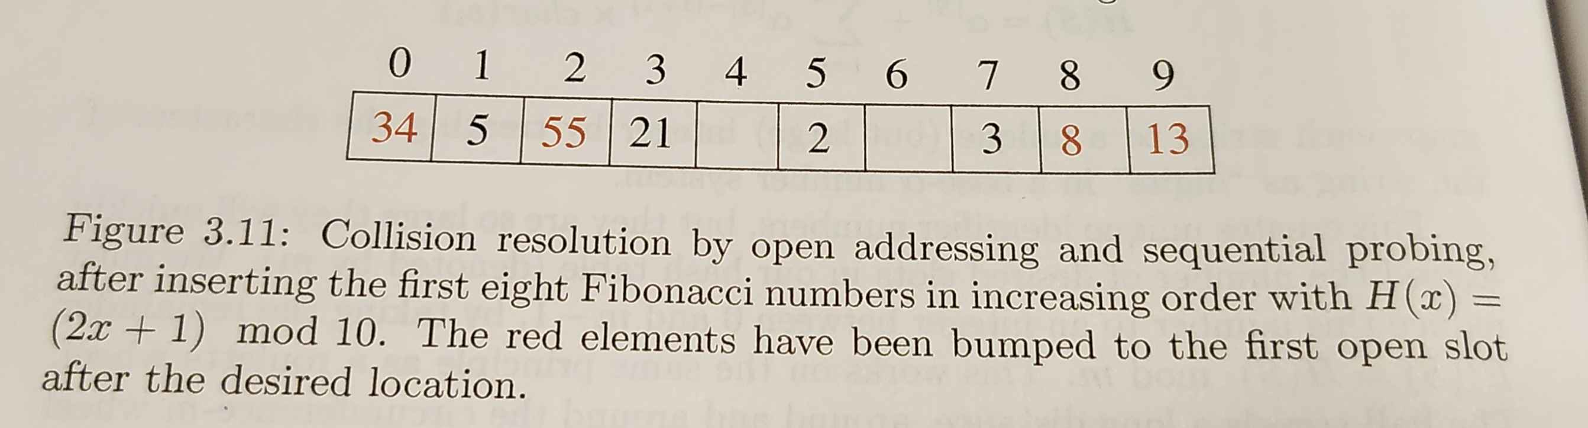

Slide 37
Graphs

Slide 38
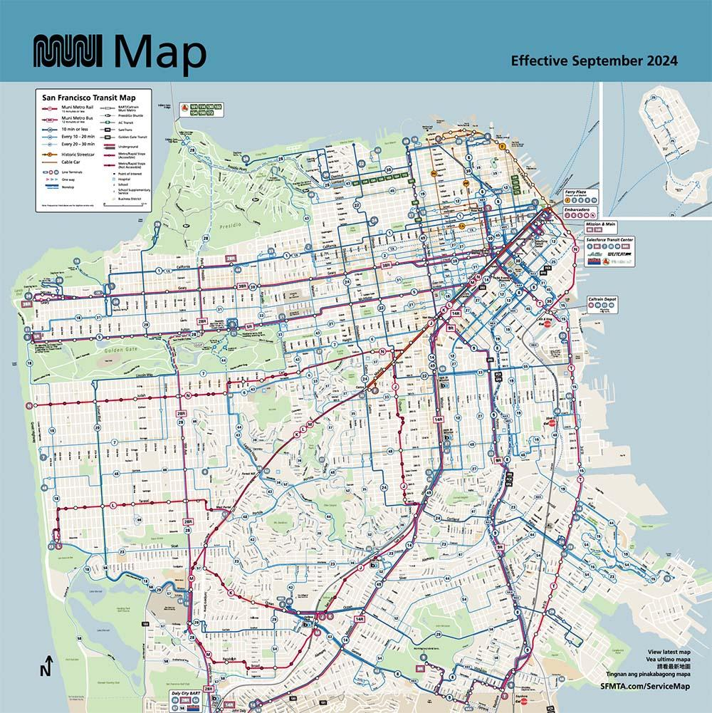

Slide 39
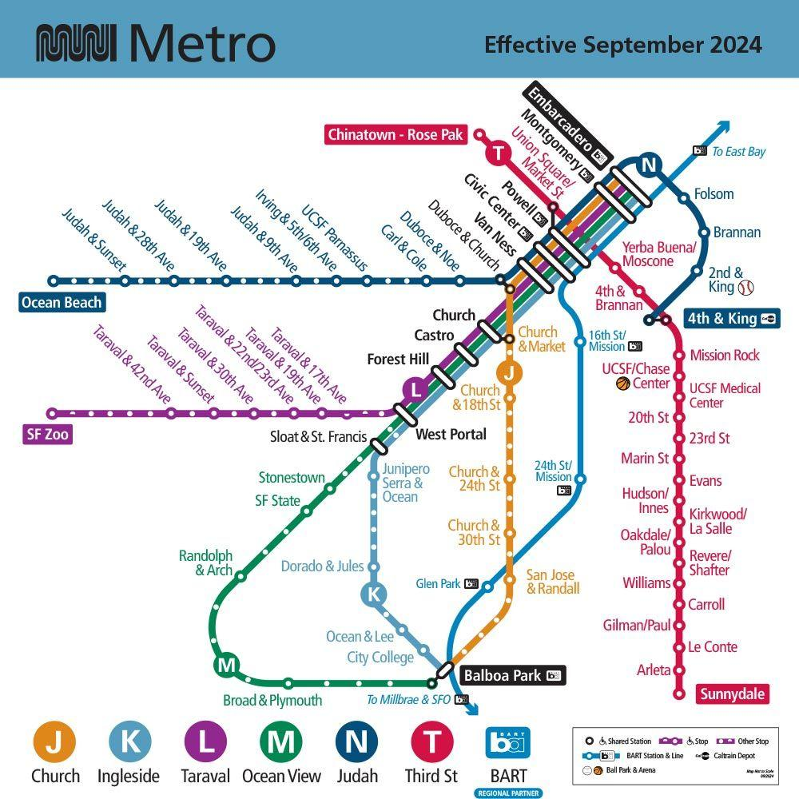
Notes:
Who here has ridden on muni in the city?
So this is the muni metro map. Well, I've got two of them. What I want to know is,
What's the difference between these two maps?
L is a map, but it doesn't represent all the features. No hwys, no streets, no parks/green areas, no distances btw the stations.
So what is on the L map?
Only the relevant things: what are the lines, and what are the stops? Where can you transfer?

Slide 40
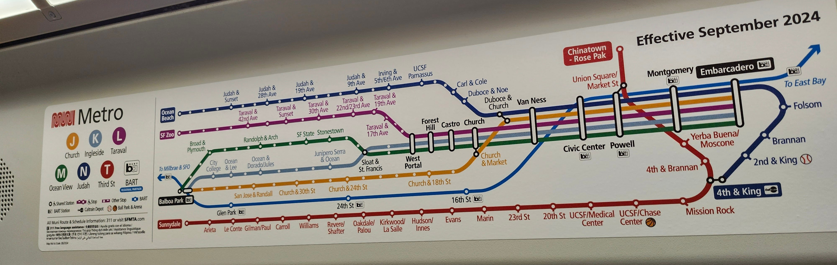

Slide 41
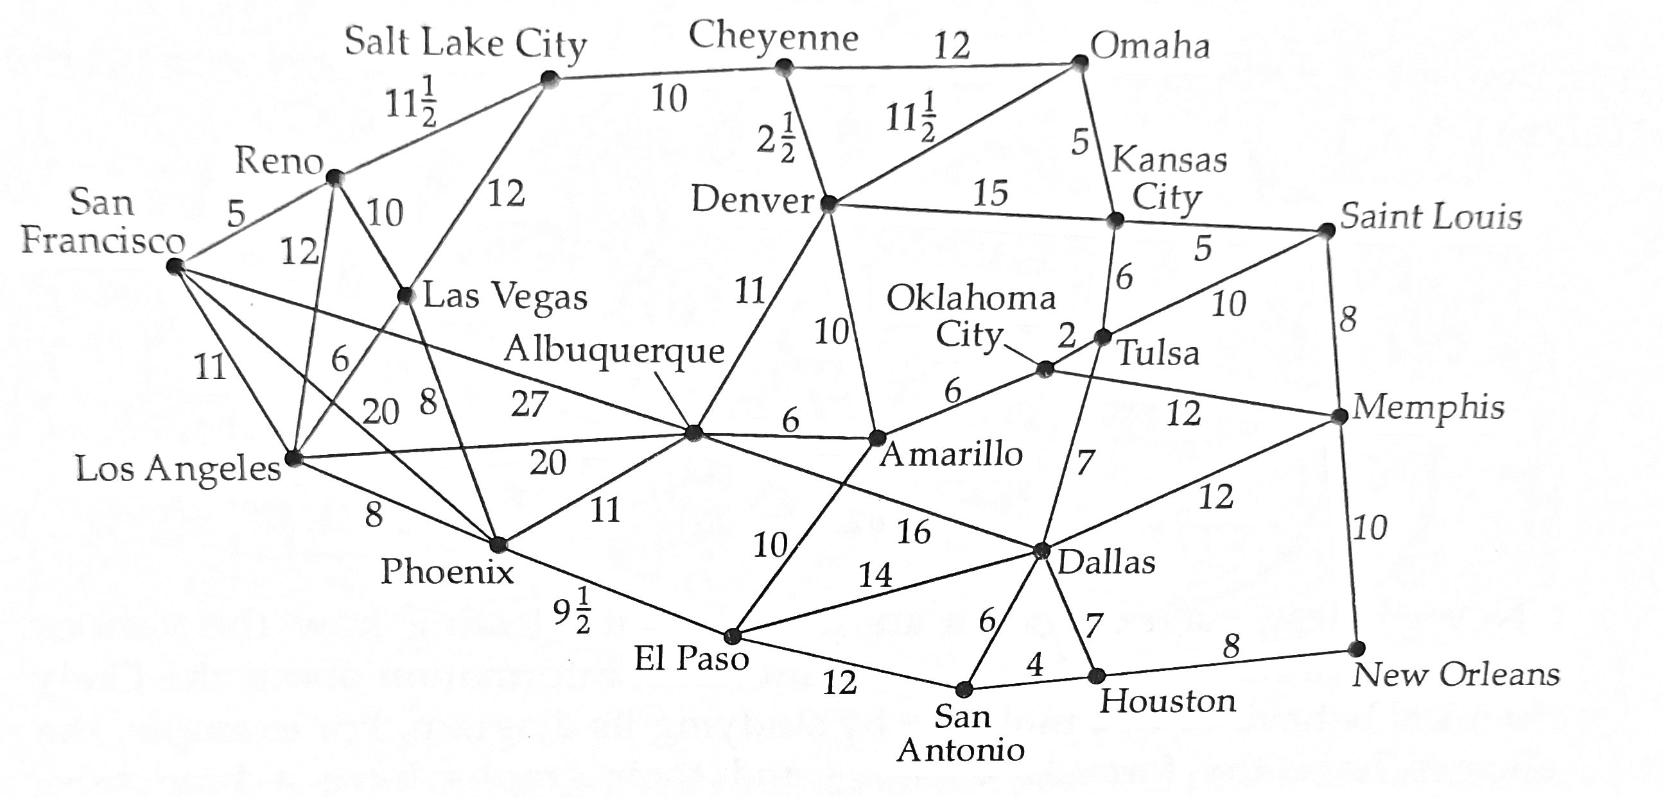

Slide 42





"The Friendship Graph" – Spider-Man edition
Peter Parker
Norman
Osborn
Yuri
Watanabe
Harry
Osborn
Miles
Morales
MJ Watson
Vertices =
Edges =

Slide 43
Questions we can ask
If I'm friends with you, are you friends with me?
Directed/undirected
How close are we?
Weight
Am I friends with myself?
Simple?
How many friends do you have?
Degree/valence
Are you an individual, or part of the crowd?
Labeled vs Unlabeled

Slide 44
Questions we can ask
Do they live close by?
Embedded graph/data on edges
Oh, you know them too?
Erdős number / Bacon number
Six degrees of separation

Slide 45
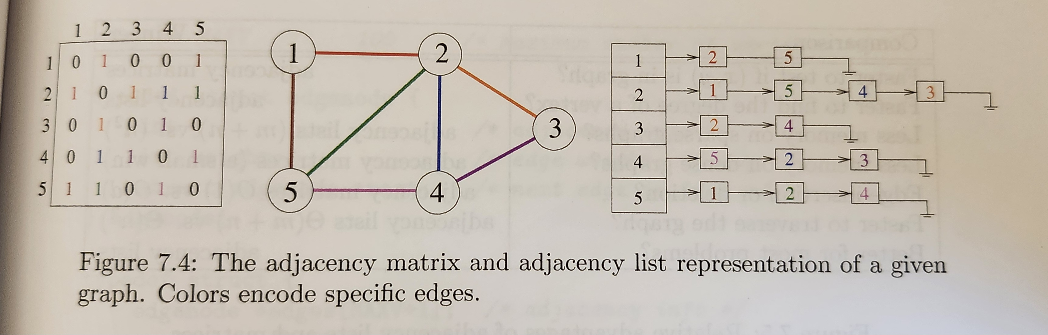
How should we represent a graph?

Slide 46
(Not) coming back around
A tree is a graph with no cycles.

Slide 47
Binary Search Trees
Fast search
Flexible update
Root – holds the top of tree (or is empty)
Child(ren) – node(s) below this node
Subtree – the BST starting from this node
BST property is: for any node x,
All left children of x are < x.
All right children of x are > x.

Slide 48
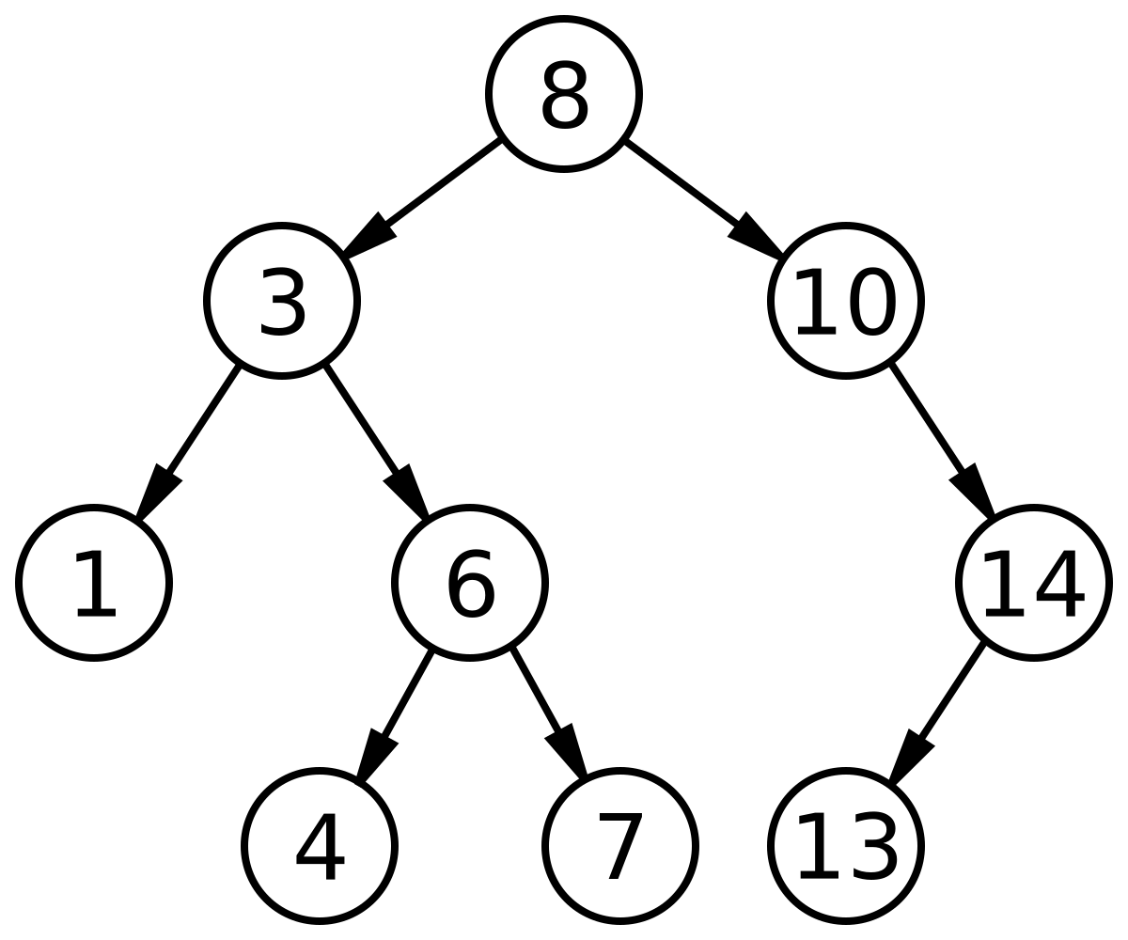

Slide 49
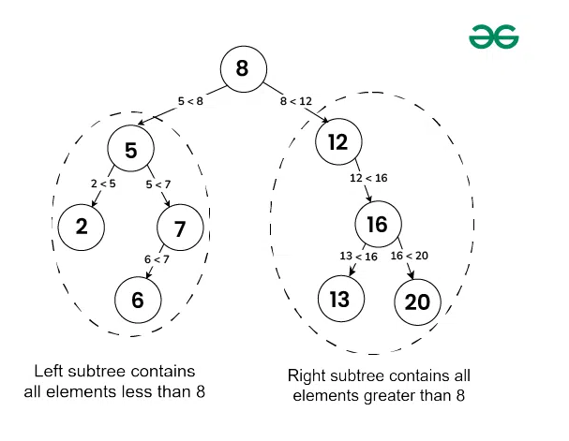

Slide 50
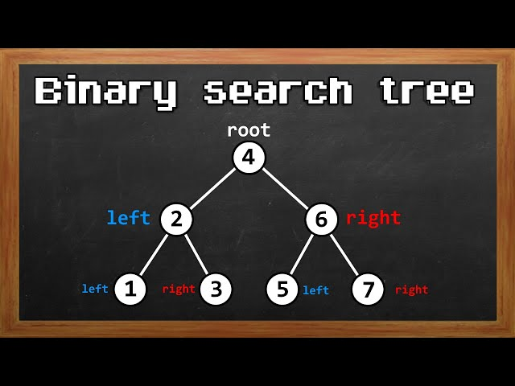

Slide 51
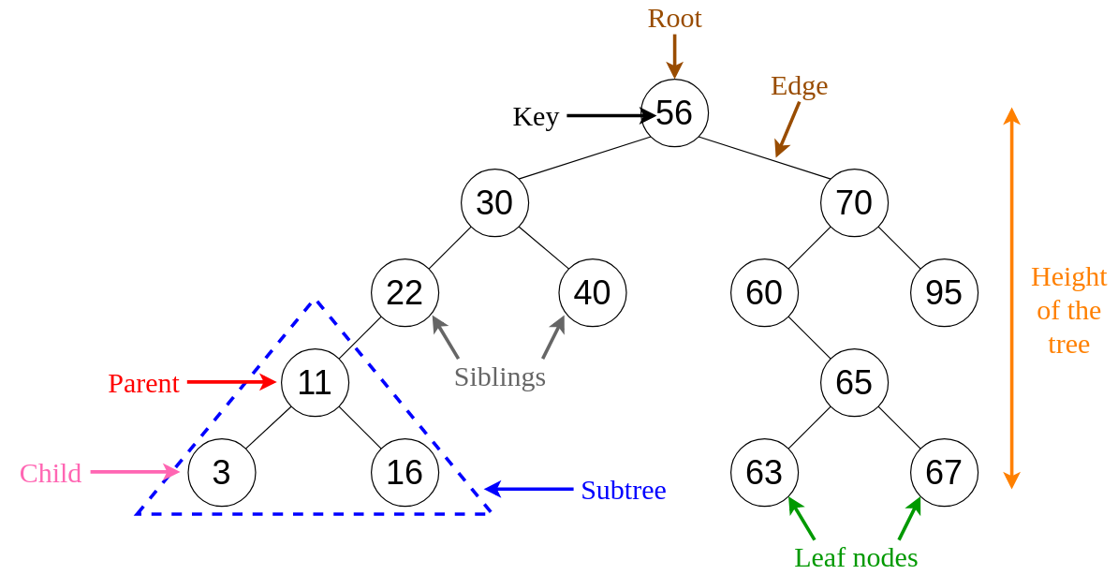

Slide 52
Graphs - Heaps
A special kind of tree:
Complete binary search tree
Complete=every node has the most possible number of children
(Min-)Heap: The value of each of a node's children is >= its own
(Max-)Heap: The value of each of a node's children is <= its own

Slide 53
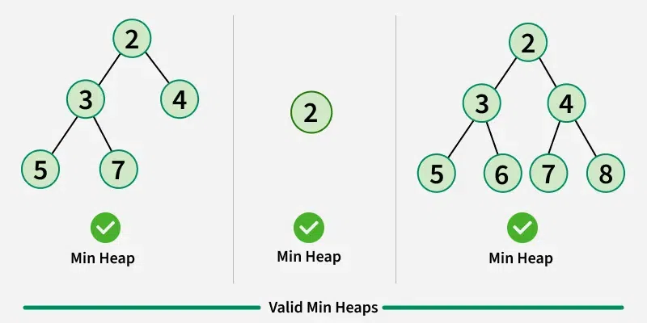

Slide 54
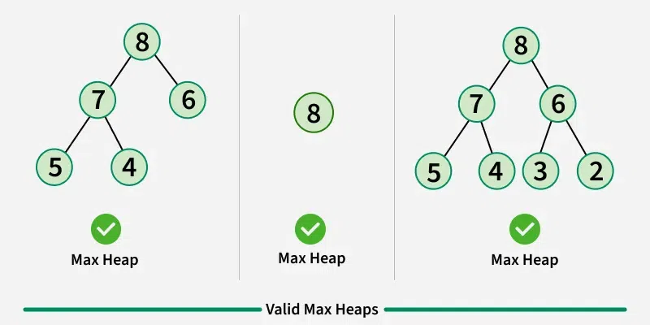

Slide 55
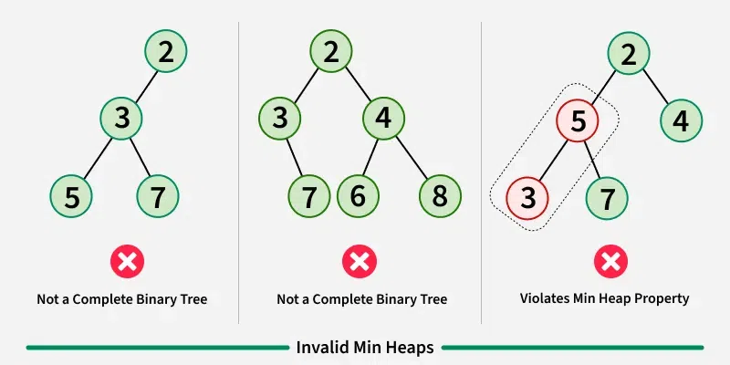

Slide 56
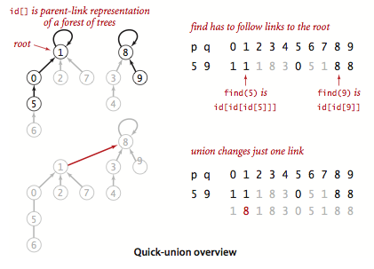
Sets - UnionFind

Slide 57
Explain the project

